Slide 1
JavaScript
1

Slide 2
A brief history of JS
In 1995, Netscape decided to add a scripting language to Navigator.
  LiveScript was shipped as part of a Navigator release in September 1995, then the name was changed to JavaScript three months later.
Microsoft debuted Internet Explorer in 1995, leading to a browser war with Netscape.
  On the JavaScript front, Microsoft reverse-engineered the Navigator interpreter to create its own, called JScript.
In November 1996, Netscape submitted JavaScript to ECMA International, as the starting point for a standard specification that all browser vendors could conform to.
  This led to the official release of the first ECMAScript language specification in June 1997.

Slide 3
A brief history of JS
European Computer Manufacturers Association (ECMA) is a standards organization for information and communication systems.
  The organization was founded in 1961 to standardize computer systems in Europe.
    ECMA-6 – 7-bit Coded Character Set (based on ASCII), also approved as ISO/IEC 646
    ECMA-107 – FAT12/FAT16 file system
    ECMA-119 – CD-ROM volume and file structure
    ECMA-262 – ECMAScript Language Specification
    ECMA-334 – C# Language Specification
    ECMA-335 – Common Language Infrastructure (CLI)
    ECMA-363 – Universal 3D File Format
    ECMA-372 – C++/CLI Language Specification
    ECMA-376 – Office Open XML
    ECMA-404 – JSON
    ECMA-408 – Dart language specification

Slide 4
A brief history of JS
Microsoft gained an increasingly dominant position in the browser market - by the early 2000s, Internet Explorer's market share reached 95%
  MS stopped collaborating on ECMA work
  During the period of Internet Explorer dominance in the early 2000s, client-side scripting was stagnant.
The successor of Netscape, Mozilla, released the Firefox browser in 2004.
  In 2005, Mozilla joined ECMA International
  In 2005, AJAX started a renaissance for JS (see next slide)
  Google debuted its Chrome browser in 2008, with the V8 JavaScript engine
  ECMAScript 6 was published in 2015.
  11th Edition – ECMAScript 2020

Slide 5
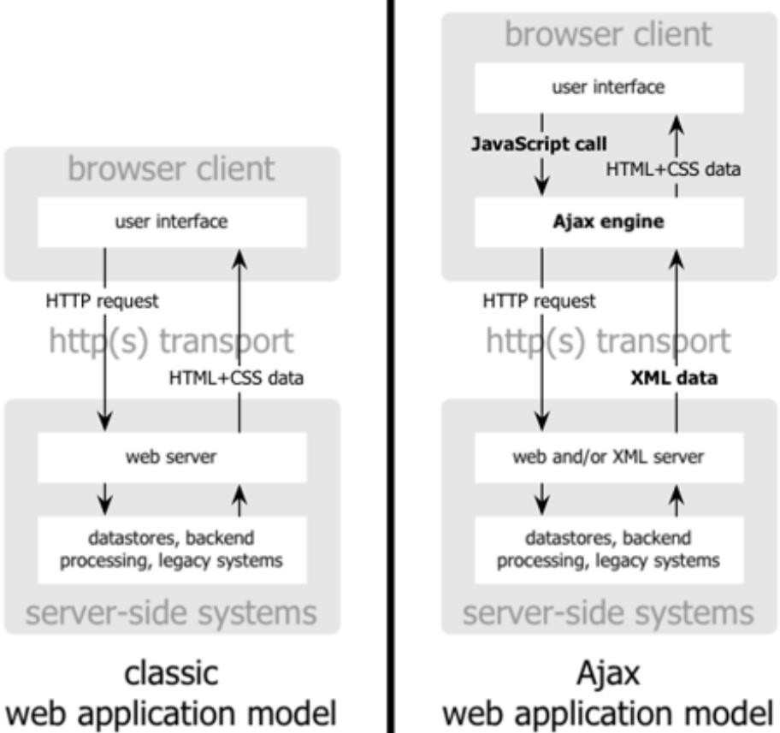
A brief history of JS
In 2005, Jesse James Garrett released a white paper in which he coined the term Ajax ( "Asynchronous JavaScript and XML") and described a set of technologies, of which JavaScript was the backbone, to create web applications where data can be loaded in the background, avoiding the need for full page reloads.

Slide 6

Overview of JavaScript
Language used in making web pages more dynamic
Typically runs in the browser
  See Chrome -> Settings -> More tools -> Developer tools
Recent extensions (Node.js) allows JavaScript to run independent of a web environment
  node

Slide 7
JavaScript
Basic Features
  Variables
  Constants
  Types
  Arithmetic Operations
  Compound Operators
  Bitwise Operations
  String Operations

Slide 8
JavaScript
Variables
  Names
    Alphanumeric
    Starting with an alpha
    Names are case-sensitive
  Can hold values of various types
  Must be declared before use
  Declared with
    var
    let ⬅ Best practice, var is being deprecated

Slide 9
JavaScript
var a = 1
a 1
  a = 2 2
let b = 1
b 1

Slide 10
JavaScript - Constants
Names holding values
Values do not change during execution
Declared with 'const' keyword

Slide 11
JavaScript - Constants
const c = 1
c 1
c = 2
Thrown:
TypeError: Assignment to constant variable.
const pi = 3.1415

Slide 12
JavaScript - Primitive Types
  Number (Note: there is no 'integer' and 'float'. All are numbers)
  String – A series of characters (inside of quotes "" or '')
  Boolean – Holds the values true or false
  Undefined – No value has been assigned to the variable yet
  NULL -
  Symbol – It represents a unique and immutable identifier.
  This makes Symbol especially useful when we want to create hidden object properties that don’t accidentally clash with other property names.

Slide 13
let id1 = Symbol("id");
let id2 = Symbol("id");
let student = {
name: "John",
[id1]: 123
};
student[id2] = 456; // doesn't overwrite id1 property
console.log(student); // { name: 'John', [Symbol(id)]: 123, [Symbol(id)]: 456 }
console.log(student[id1]); // 123
console.log(student[id2]); // 456

Slide 14
JavaScript - Types
Examples:
var a; // Declare variable a
a null
a = 1.1
a 1.1
a = "Paul"
a "Paul"
a
a = true;
a true
// Boolean value

Slide 15
JavaScript – Arithmetic Operations
// Operators: +, -, *, /, %,
a = 5;
b = 11;
c = 33;
d = a + b; 16
e = c % b; 0
f = a * a * pi; 78.53750000000001

Slide 16
JavaScript – Bitwise Operators
// Operators &, |, ~, ^, <<, >>
aa = 5;
bb = 11;
cc = 12;
dd = 201;
ee = 2;
ff = bb << ee; 44
gg = bb & cc; 8
hh = cc | aa; 13
// 11 shift left 2 bits => 44
// 12 and 11 => 8
// 12 or 5 => 13

Slide 17
JavaScript – Compound Operators
// Operators +=, -=, *=, /=, %=, &=, |=, ^=, <<=, >>=
// Combine assignment and an operation. Operation stores into the first operand (to the left of the operator!)
a += b; 16
c %= b; 0
a *= a * pi; 804.224
bb <<= ee;
bb &= cc;
// 11 shift left 2 bits => 44
// 12 and 11 => 15
cc |= aa;
// 12 or 5 => 13

Slide 18
JavaScript – String Operations
str1 = 'Hello';
str2 = 'World';
greeting = str1 + ', ' + str2 + '!'; // String concatenation
➔ Hello, World!
// Length of string (.length is a 'property' not a 'method')
lengthOfString = greeting.length; // Assigns 13
// Strings may be indexed with squarebrackets to return a specific character
theComma = greeting[5]; // puts a , in theComma
// Strings are immutable! Cannot be changed (but can be replaced!)
greeting[5] = ';' // This produces an error
greeting = "Hello; World!"; // This is fine!
17

Slide 19
JavaScript – String Operations
// Strings are 'objects' and have associated methods
.indexOf(substring, <start_position>) – Return the index of where the first matching substring starts
.lastIndexOf(substring, <start_position>) – Return index of where last matching substring starts.
.slice(startpos, enpos) – Extracts and returns a substring from positions startpos to (endpos – 1). Position can be negative meaning they are counted from the end of the string.
.substring(startpos, endpos) – Same as slice but negative positions are
disallowed.
.substr(startpos, length) – Extracts a substring from startpos for given length.
.replace(substring, newstring) – Searches the string and replaces the first argument value, if found, with the value newstring.
.toUpperCase() – Converts the entire string to uppercase characters
.toLowerCase() – Converts the entire string to lowercase characters
.charAt(position) – Returns the character at the location given by position
.charCodeAt(position) – Returns the UTF-16 value (0-65535) of the character at position
18

Slide 20
JavaScript – String Operations
a = 'Paul' 'Paul'
a.indexOf('a',1) 1
a.lastIndexOf('a') 1
a.slice(1,3) 'au'
a.slice(-3,-1) 'au'
a.substr(0,2) 'Pa'
a.replace("a","e") "Peul"
a.charCodeAt(1)
19
97

Slide 21
When we write JavaScript programs, we need two main ways to interact with users:
Output → displaying information on the screen.
Input → receiving information from the user.
JavaScript provides several built-in methods for both tasks.

Slide 22
Screen Output Methods
alert()
Displays a popup message box with an OK button.
Mainly used for simple notifications or debugging.
alert("Welcome to JavaScript!");
console.log()
Outputs messages to the browser console (used by developers).
Does not show anything on the webpage directly.
Best for debugging and testing.
let x = 10, y = 20;
console.log("The sum is:", x + y);

Slide 23
document.write()
Directly writes content into the HTML document.
Useful for simple demos, but not recommended for modern applications (it can overwrite the entire document if used after page load).
document.write("<h2>Hello, World!</h2>");
innerHTML
Allows us to modify HTML content of an element.
More flexible and widely used compared to document.write().

Slide 24
<!DOCTYPE html>
<html>
<body>
<p id="msg"></p>
<script> document.getElementById("msg").innerHTML = "Hello, Students!";
</script>
</body>
</html>

Slide 25
Keyboard Input Methods
Unlike traditional programming languages, JavaScript cannot directly read from the keyboard in a console. Instead, it uses popup dialogs or form elements in HTML.
prompt()
Displays a dialog box asking the user for input.
Returns the input as a string (always string, even if numbers are typed).
let name = prompt("Enter your name:");
alert("Hello, " + name + "!");
Document.write(“hello,”+ name +”!” );

Slide 26
<!DOCTYPE html>
<html>
<body>
<h1>Demo: prompt()</h1>
<button onclick="myinput()">Click to enter your name</button>
<p id="msg">hello world</p>
<script>
function myinput(){
var name = prompt("Enter Your Name:");
if (name == null || name == "") {
document.getElementById("msg").innerHTML = "You did not entert anything. Please enter your name again";
}
else
{
document.getElementById("msg").innerHTML = "You enterted: " + name;
}
}
</script>
</body>
</html>

Slide 27
Write a Javascript program to create a login simulation program that prompts the user for a username and password using prompt. If the username and password match with the pre-defined values, display a success message with alert. If not, use confirm to ask if they want to try again. If they agree, re-prompt for credentials.

Slide 28
JavaScript – Control Flow statements
Control flow statements
  if/else
  switch
  for
  while

Slide 29
if/else
If/else is similar to other languages
  Format:
if (condition) {
// Code to run if condition is true
} else if (condition2) {
// Code to run if condition2 is true
} else {
}

Slide 30
Switch statement
Switch statement is like a chained 'if'
Similar to other languages like 'C'.
Syntax:
switch (value) { case <value_1>:
// code if value == value_1
break; // causes JavaScript to skip remaining case clauses case <value_2>:
// code if value == value_2
break;
….
default:
// code if no cases match
}

Slide 31
switch statement example
function analyzeResponse(resp) {
switch (resp) { case 1:
retValue = "New York"; break;
case 2:
retValue = "Los Angeles"; break;
case 3:
retValue = "Chicago";
break; default:
retValue = "No joy – I'm not seeing it!";
}
return retValue;
}

Slide 32
for loops
Similar to C and Java's for-loop
Format:
for (initialization; loop-end-test; end of loop code) { loop body
}

Slide 33
Example: for loop
for (i = 0; i < 10; i++) { console.log(i + " : " + i*i);
}
0 : 0
1 : 1
2 : 4
3 : 9
4 : 16
5 : 25
6 : 36
7 : 49
8 : 64
9 : 81

Slide 34
while loops
Iterates while a condition is true
Syntax:
while (condition) {
// Code to execute as long as the condition evaluates to true
}

Slide 35
while loop example
function generateTable(tableSize) { let i = 0;
if ((tableSize > 0) && (tableSize <= 10000)) { console.log("num : num^2");
while (i < tableSize) { console.log(i + " : " + i*i); i++;
}
}
}

Slide 36
do while loops
Iterates while a condition is true
Always iterates at least 1 time since test is at the end!
Syntax:
do {
// Code to execute as long as the condition evaluates to true
} while (condition)

Slide 37
do while loop example
function generateTable(tableSize) { let i = 0;
if( (tableSize > 0) && (tableSize <= 10000)) { console.log("num : num^2");
do {
I
console.log(i + " : " + i*i);
} while (i < tableSize)
}
}

Slide 39
Objects
Objects contain multiple related values
Values indexed by a property name or string
var student1 = { "firstName" : "John",
"lastName" : "Smith",
"year" : "sophomore",
"major" : "CSE"
};
Properties
Values

Slide 40
Objects
Property values can be set or accessed using:
  Dot notation
  Bracket notation – Must use this method if the 'property' contains a space
// Dot notation
fName = student1.firstName; student1.year = "Junior";
// Bracket notation
lName = student1["lastName"]; student1["major"] = "ISE"; property = "gradYear"; student1[property] = 2020;

Slide 41
JavaScript - Arrays
Arrays hold multiple values
Collections are specified in square brackets with comma separated values
array1 = [0, 1, 4, 9 ,16, 25]
array2 = ["John", 1, "Mary", 2]
// Arrays in JavaScript can be heterogeneous array3 = [[2, 3, 4], [1, 5, 10], [2, 20]]
// Arrays can hold arrays!

Slide 42
JavaScript - Arrays
Element values can be indexed with a single integer in square brackets
  array1 = [0, 1, 4, 9 ,16, 25]
[ 0, 1, 4, 9, 16, 25 ]
  array1[0] = 1 1
  array1
[ 1, 1, 4, 9, 16, 25 ]
  array2 = ["John", 1, "Mary", 2]
  aName = array2[2]; // Puts 'Mary' in aName
  array3 = [[2, 3, 4], [1, 5, 10], [2, 20], [1, 2, 3, 5, 7, 11]]
  deepDive = array3[2][1]; // Puts 20 into deepDive

Slide 43
JavaScript – Arrays (array methods)
Array is an object (reference type) and has methods that do certain operations on the
array.
.push(newelement) – Adds an item to the end of the array
.pop() – Removes the last array element and returns it
.shift() – This removes the first element of an array and returns it
.unshift(newelement) – This adds an element to the beginning of an array
array1 = [0, 1, 4, 9 ,16, 25]
array1.push(7) 7
console.log(array1) [ 0, 1, 4, 9, 16, 25, 7 ]
Array1.push(35)
array1.pop() 7
array1.shift() 0
array1
[ 1, 4, 9, 16, 25 ]
array1.unshift(8)
6
array1
[ 8, 1, 4, 9, 16, 25 ]
// lenght
24

Slide 44
JavaScript – Functions
Functions can hold related code
Defined with the function keyword
Can take arguments
Can return a value to the caller with the return
keyword

Slide 45
JavaScript – Examples: Functions
function add5(arg1) { return arg1+5;
}
console.log(add5(6)); 11
function average(arg1, arg2) { var avg = (arg1 + arg2) / 2; return avg;
}
console.log(average(10,17)); 13.5
Takes 1 parameter
Returns the sum of the argument and 5
Call add5() with an argument of 6
Takes 2 parameter
Call average() with arguments of 10 and 17

Slide 46
JavaScript - Arrow functions
Shorthand way to write anonymous functions
No function keyword
Syntax:
const <varname> = () => {
// code for function
}
If code only returns a value, you can skip the return keyword and curly braces!

Slide 47
JavaScript - Arrow functions examples
const arrow1 = () => { console.log("An arrow func!");
}
arrow1();
const squareArrow = (x) => x * x; console.log(squareArrow(5));
Output:
An arrow func! 25

Slide 48
JavaScript – Higher order arrow functions
Arrow functions can be passed to other functions that will apply them to a number of inputs
  map()
  filter()
  reduce()

Slide 49
map — runs on each element and returns a new array of the results.
filter— runs on each element; keeps elements where returns true.
Reduce — runs to accumulate a single value from the array (like sum, object, etc.) receives an accumulator and current value.

Slide 50
const products = [
{ id: 1, name: 'Pen', price: 10, category: 'stationery' },
{ id: 2, name: 'Notebook', price: 40, category: 'stationery' },
{ id: 3, name: 'Mug', price: 150, category: 'kitchen' },
{ id: 4, name: 'Plate', price: 80, category: 'kitchen' },
{ id: 5, name: 'Bag', price: 500, category: 'accessories' }
];

Slide 51
1) map(): get an array of prices
const prices = products.map(p => p.price);
console.log(prices); // [10, 40, 150, 80, 500]
2) filter(): get only kitchen products (keeps full objects)
const kitchenItems = products.filter(p => p.category === 'kitchen');
console.log(kitchenItems);
3) reduce(): sum of all prices
const totalAll = products.reduce((acc, p) => acc + p.price, 0);
console.log(totalAll); // 780

Slide 52
JavaScript – Higher order arrow functions - Example
nums = [5, 10, 25, -4, 10, -13, 100]
console.log("nums: " + nums); nums: 5,10,25,-4,10,-13,100
newnums = nums.filter(x => x >= 0).map(x => Math.sqrt(x)); console.log("newnums: " + newnums);
newnums: 2.23606797749979, 3.1622776601683795, 5,
3.1622776601683795,10
Red text are arrow functions passed into other functions
Output of filter() which is passed into map() is: [5,10,25,10,100] map() then runs Math.sqrt() on each element

Slide 53
Create an array of numbers, use map() with an arrow function to return a new array with each number doubled.
Use filter() to get only the odd numbers from an array.
Use reduce() to calculate the sum of an array.
Create an array of strings, use map() to convert each string to uppercase.
Create an array of ages, filter only people who are 18 or older and Use reduce() to find the maximum number in an array.
Create an array of objects representing students. Use filter() and map() together to get the names of students who scored more than 50.

Slide 54
JavaScript – spread operator (…)
Spreads elements from an array apart into individual members
Can use it to 'copy' an array rather than having an 'alias' to an array
anArray = ['a', 'b', 'c', 'd', 'e'] let arr2;
let arr3; (function() {
arr2 = anArray; // This is an alias
arr3 = [...anArray]; // This spreads out the elements in anArray and builds a new array anArray[0] = 'z';
})();
console.log("arr2: " + arr2); console.log("arr3: " + arr3);
Output:
arr2: z,b,c,d,e
arr3: a,b,c,d,e
Note: arr2 is affected by assignment since it is an 'alias' of anArray, but arr3 is a separate 'copy' of the array due to using the spread operator.

Slide 55
JavaScript – Destructuring objects
Easy way to extract fields of an object into separate variables
  Previously, needed a separate assignment for each field or member
Syntax:
const {fieldname1 : targetvar1, fieldname2 : targetvar2, …} = objectname;
Example:
let personInfo = {name:"Sam", age: 55, gender: "Female"};
const { name : pDataName, age : pDataAge, gender : pDataGender } = personInfo; console.log ("Name: " + pDataName);
console.log ("Age: " + pDataAge); console.log ("Gender: " + pDataGender);
Output: Name: Sam Age: 55
Gender: Female

Slide 56
JavaScript – Destructuring arrays
Arrays can similarly be 'destructured'
Elements are 'positional' so…
  must assign elements in order they are in the array
  can 'skip' values from array by just adding commas ','
Syntax:
const [varname1, varname2, …] = arrayName;
Example:
const myArr = [1, 2, 3, 4, 5]
const [a, b, , , c] = myArr; // Puts 1 into a, 2 into b and 5 into c console.log("a=" + a + ",b="+ b + ",c=" + c);
Output:
a=1,b=2,c=5
Extra commas skip
elements 3 and 4!

